Slide 1

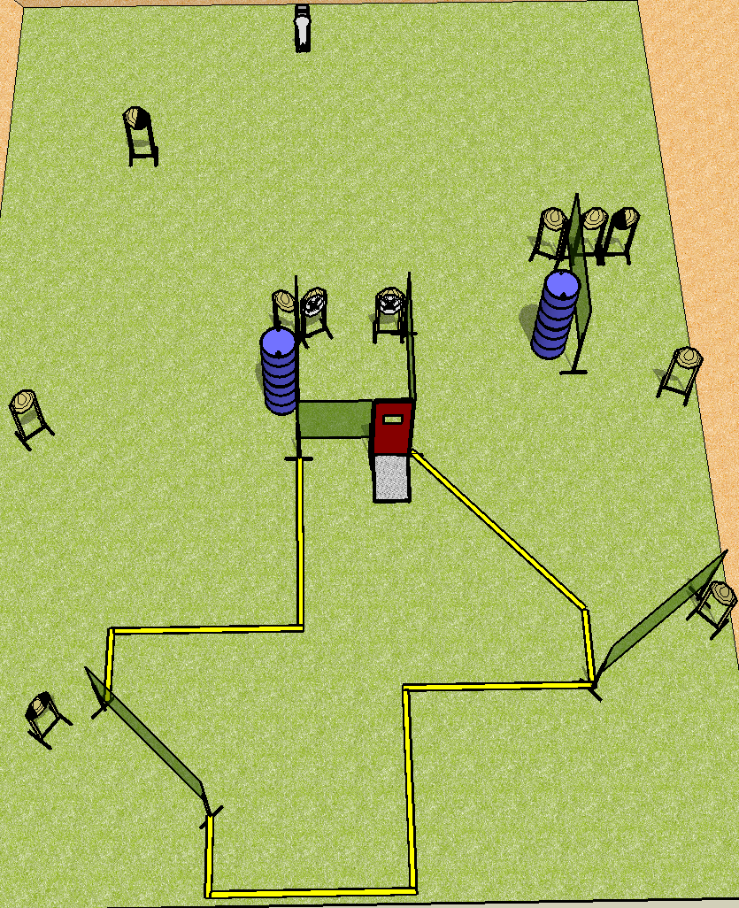
 | Dothan Practical Shooters – USPSA Match Just One More Minute Course Designer : Drew Coleman Bay: B4
Round Count 12 rounds 11 IPSC 1 colt popper
Equipment List 11 wall feet Pull cord port 1 tux, 1 left diag, 1 right diag 10 targets (8 + 2NS)

Slide 2
Just One More Minute
Written Stage Briefing
Scoring: Comstock Rounds: 12 rounds. Best one hit per target
Targets: 11 IPSC, 1 steel
Handgun start position: inside shooting box at port, wrists below belt. Handgun is UNLOADED and holstered.
PCC start position: inside shooting box at port, stock on belt. UNLOADED carbine is held with both hands.
Stage Procedure: on the audible start signal, engage targets as they become available from within the shooting area.
The box at the port is part of the shooting area.

